Slide 1
27 April 2022

Slide 3
UNCLASSIFIED
German Army Liaison Office
at US Army Combined Arms Center
CASO PANEL April 27, 2022
Strategic implications of china‘s
Global power projection
The European Perspective
COL (GS) Michael kopp

Slide 4
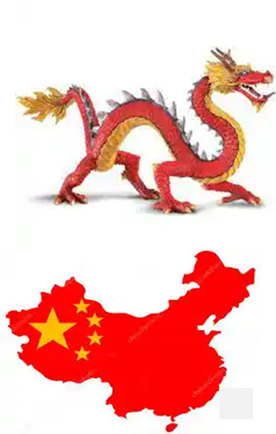
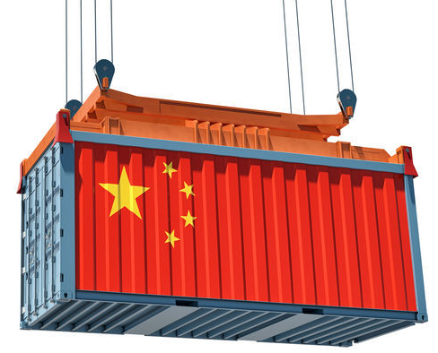
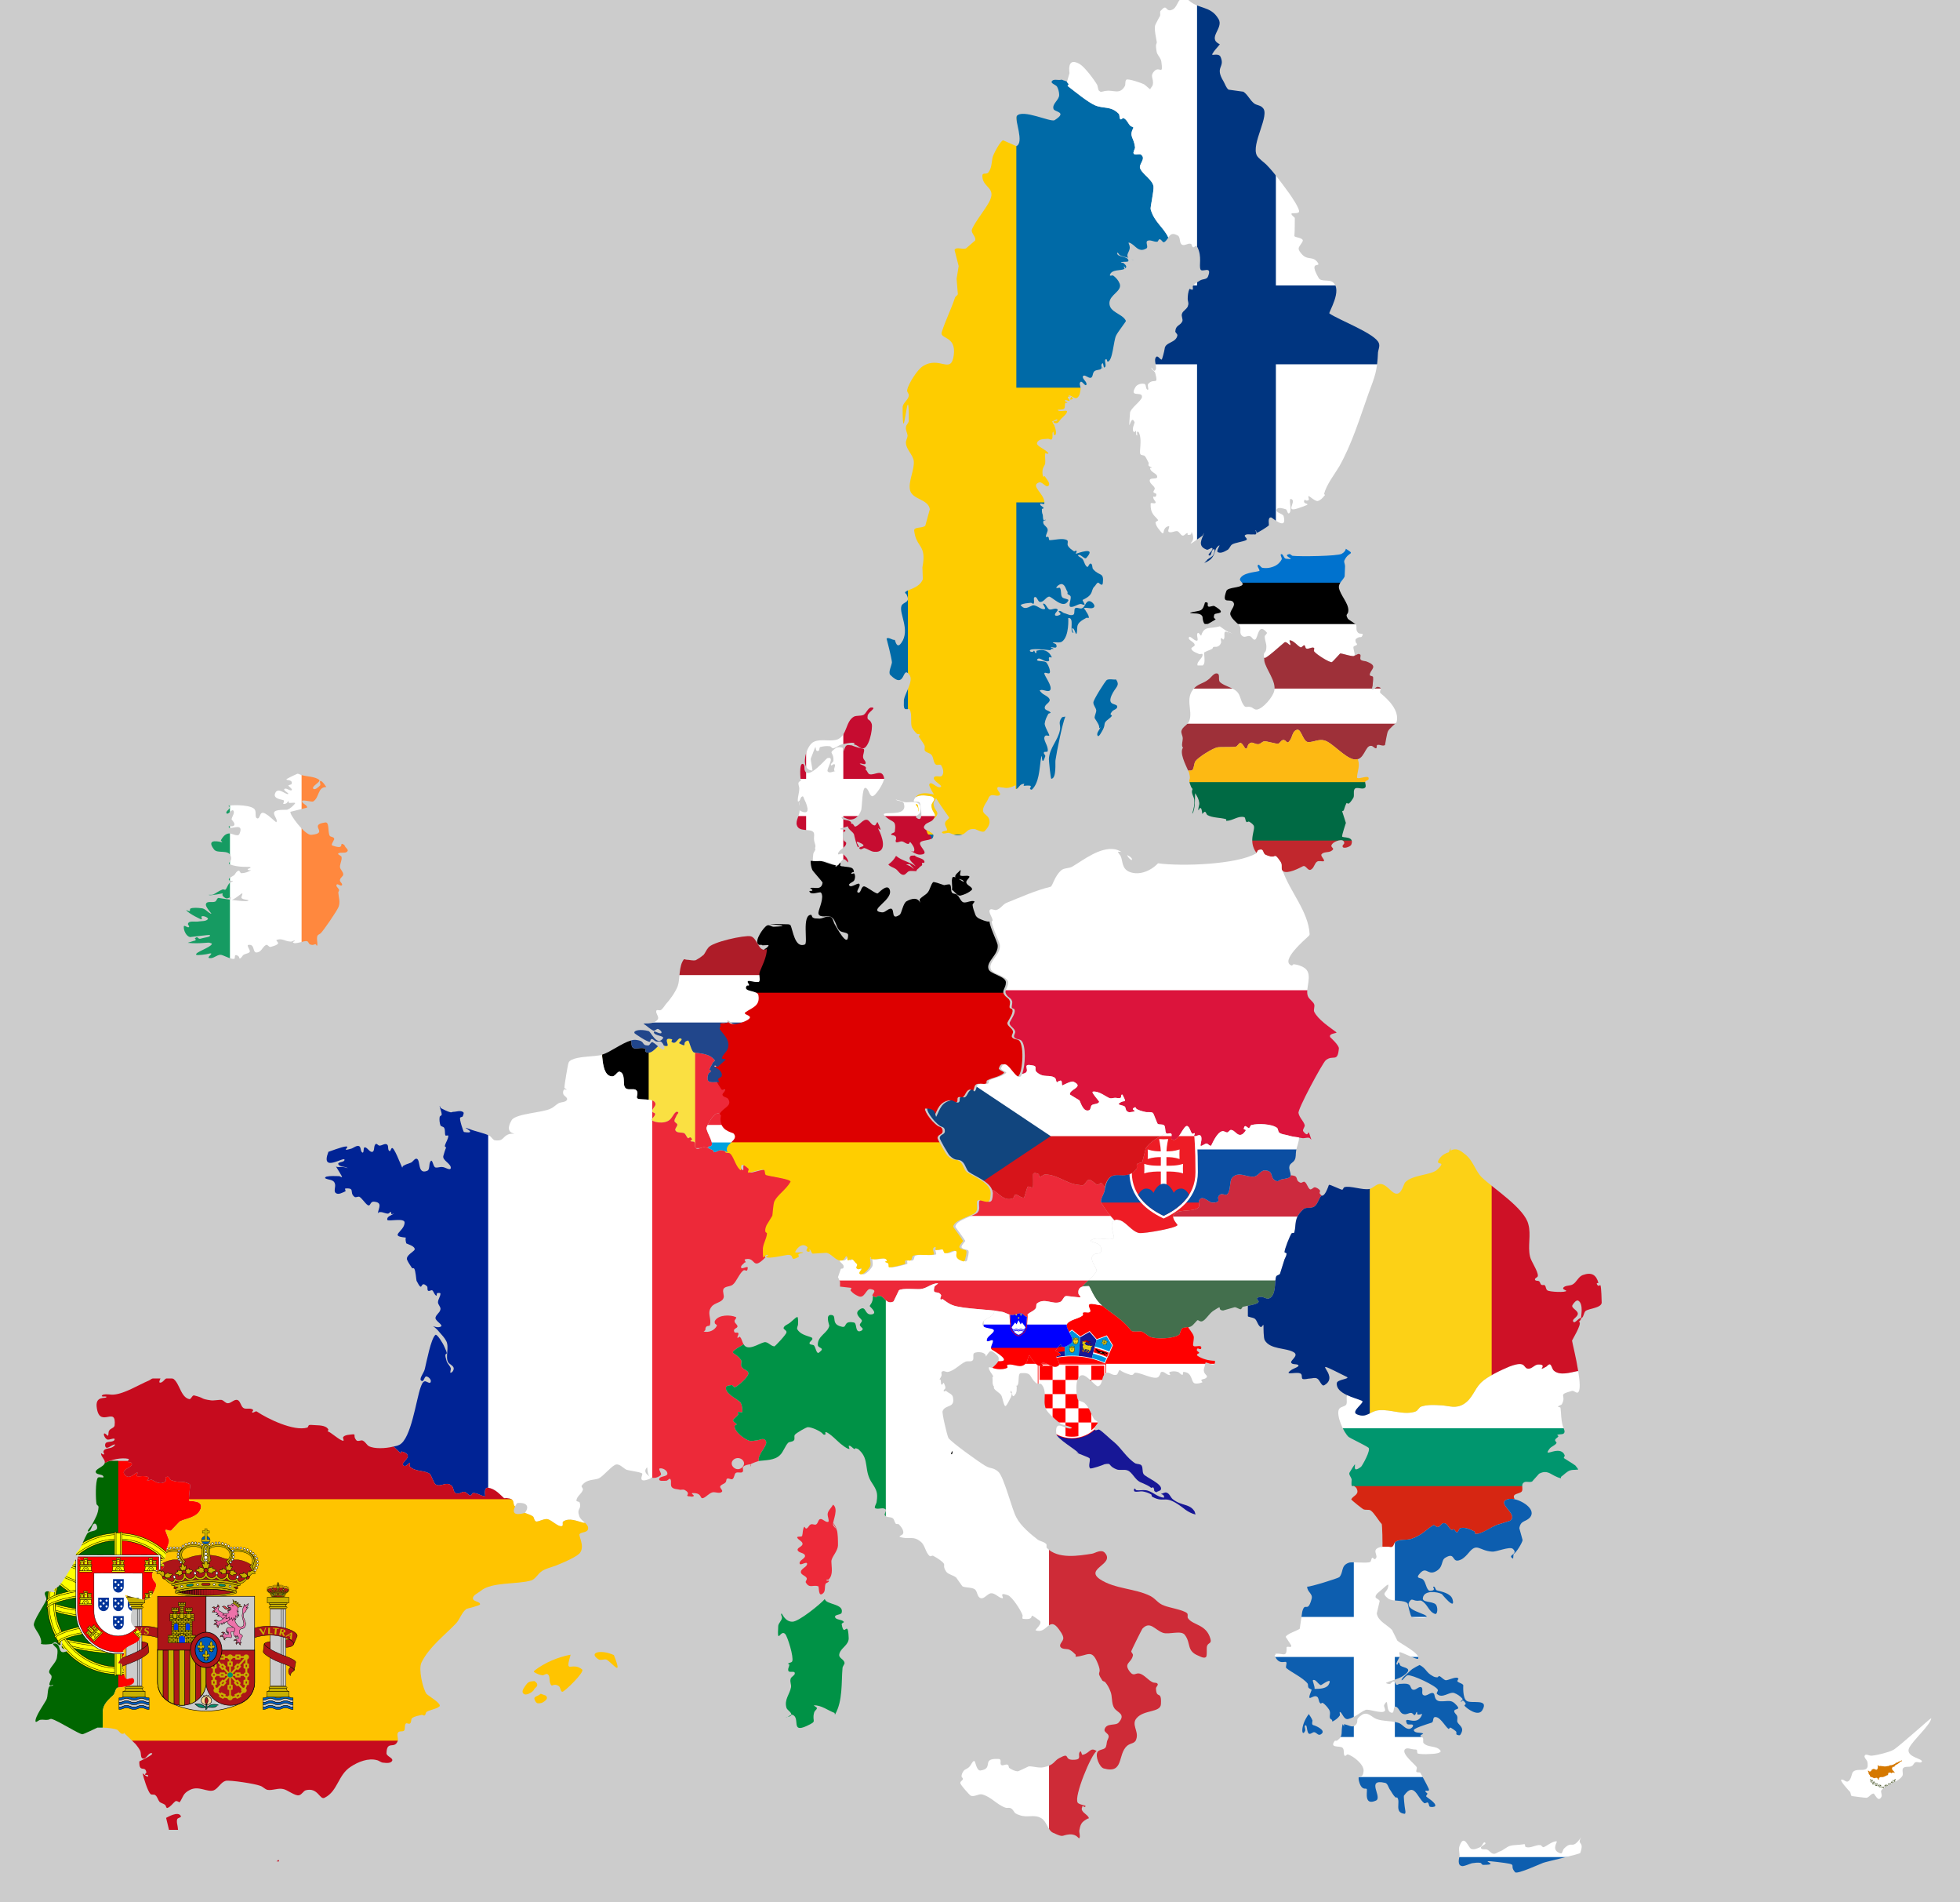
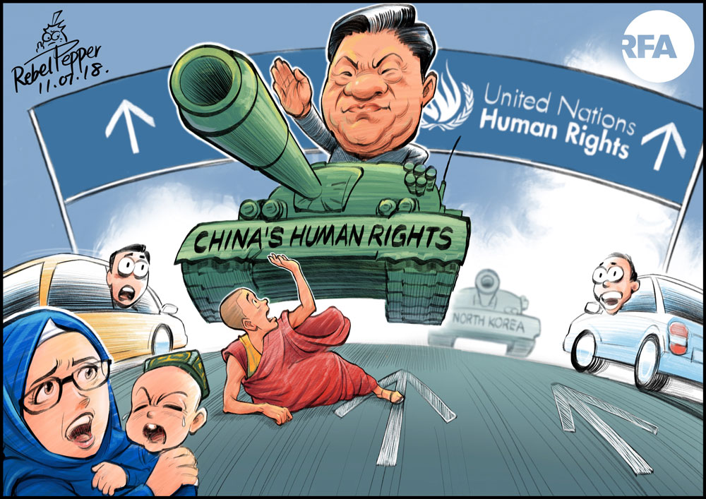
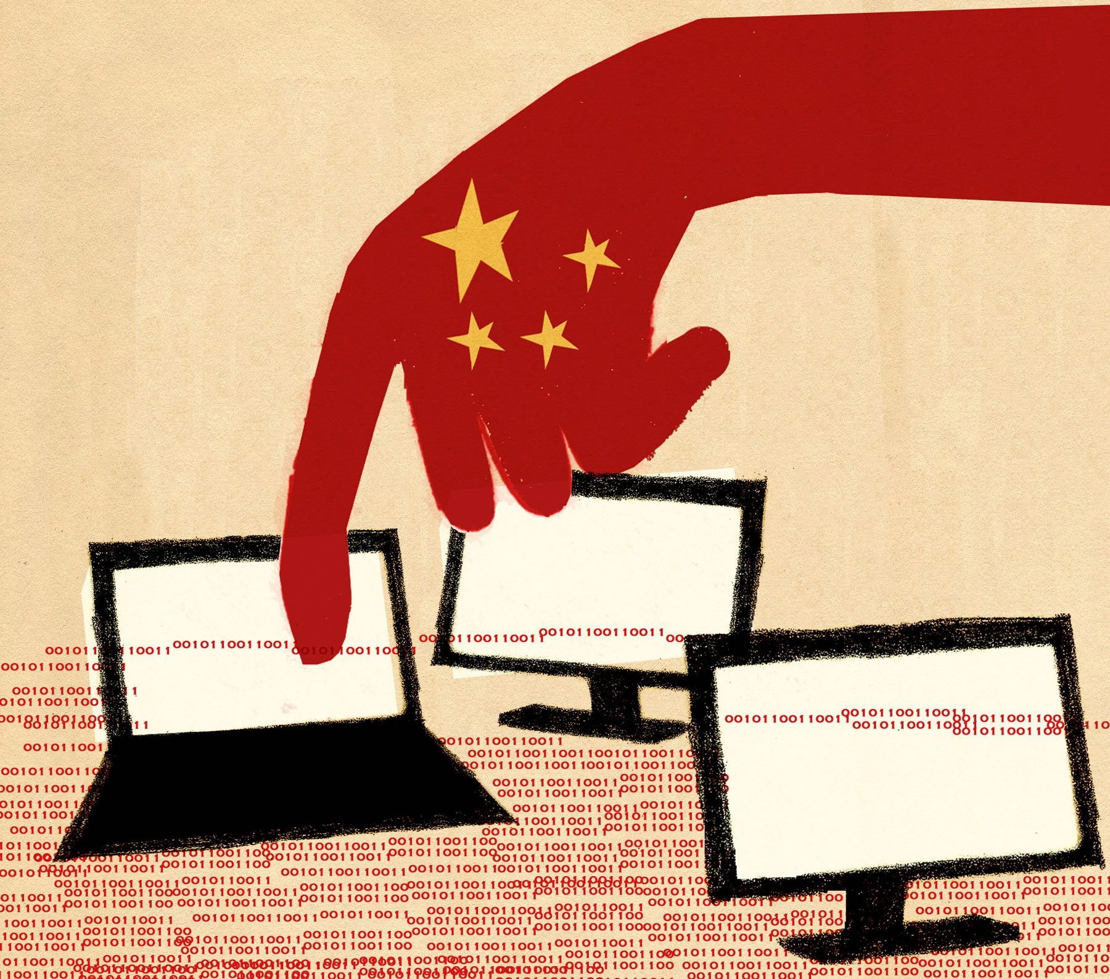
UNCLASSIFIED
European Union and China
Complex relationships as a function of:
Side by side
With each other
But more and more
Against each other
9,6 million km²
I,4 Billion inhabitants
16,4% of the Worlds GDP
4 million km²
447.7 Million inhabitants
16% of the Worlds GDP (US 16.3%)
Dependency

Slide 5
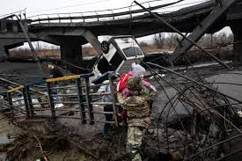
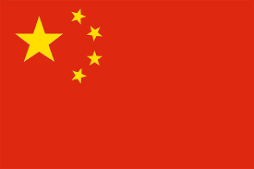
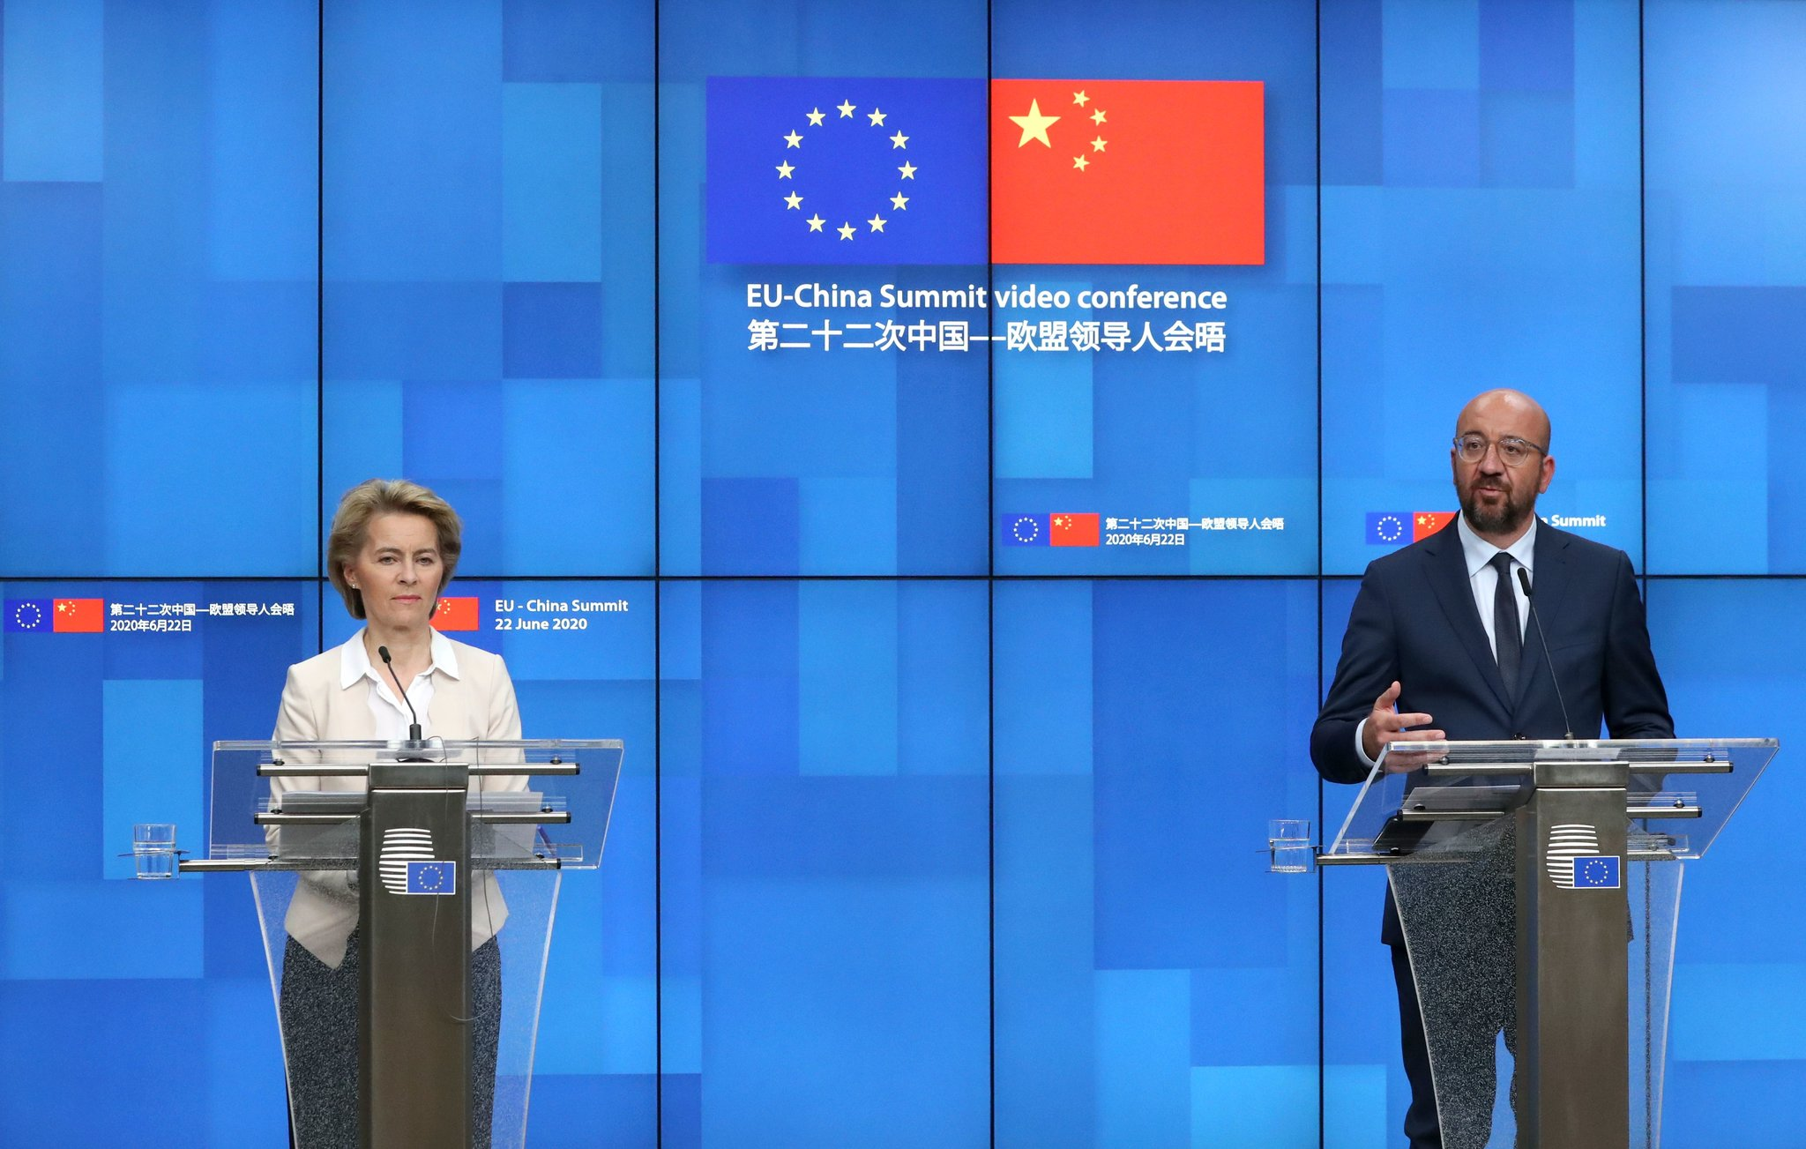
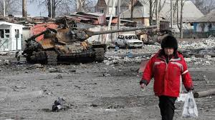
UNCLASSIFIED
UKR – RUS war as a catalyst
Trust in
decline
Feb 2022: 5000 word statement
“Limitless friendship”
March 2022: Strengthen the strategic partnership
April 01, 2022
Confident EU appearance
Warning to China
Definition of red lines towards China
Profound Change
Strategic priorities
Unity
Awareness for weaknesses

Slide 6
UNCLASSIFIED
Summary/Conclusion (1)
China and Chinese economy matters!
Power of international and especially transatlantic unity.
Wake up call UKR – RUS War:
EU is moving towards a more power oriented policy and strategic approach.
Reassessment of EU China relations.
Requirement for solidarity with the US as well as with Nations within the Pacific region.
Be aware of the Chinese perception: The West next strategic target is China!

Slide 7
UNCLASSIFIED
UNCLASSIFIED
Summary/Conclusion (2)
“We don’t need China to be with us. We just need them not to be against us”.
Frank Januzzi, President and CEO
Maureen and Mike Mansfield Foundation
“We have reached a turning point. We have China and Russia acting in concert now, boldly challenging the US for global leadership…In the past we have been saying deterrence works. Now we have to ask ourselves: Is deterrence enough?”.
Gen ret. Hans Lothar Domroese,
former Cdr NATO HQ JFC Brunsum

Slide 8
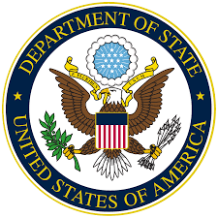
Strategic Implications of China’s Global Power Projection
Mr. Terry D. Mobley
U.S. Department of State
U.S. Army Command and General Staff College
Fort Leavenworth, KS
Presentation for the
Cultural and Area Studies Office
U.S. Army Command and General Staff College
27 April 2022
unclassified

Slide 9
What is the Belt and Road Initiative?
At its core, the BRI is an infrastructure investment program with estimated funding of at least $1 trillion USD; total value of BRI projects to date are estimated to be around $2 trillion.
More broadly, it’s the vehicle through which China intends to increase its connectivity – “physically, financially, digitally, and socially” (UNDP China, 2019) with countries as well as regional and international organizations based partly on the historic Silk Road land and maritime routes.
It is also a tool through which China seeks to improve it’s economic, security, and political standing both regionally and globally, while increasing other countries dependency on China.
Notes:
The BRI is good and bad and it is a mistake for the US to characterize it as all bad. The BRI offers infrastructure investment in countries that have serious infrastructure needs and often no other funding options. However, if countries leaders make bad deals, it can lead to a level of dependency on China that China can take advantage of.
In the fall of 2017, the Belt and Road Initiative was incorporated into China’s Constitution. This put a damper on some commercial bank representatives who were previously willing to complain about giving loans to BRI projects that had little chance of a financial return on investment. Once the BRI was added to the constitution, complaining about BRI loans would be seen as a much more direct attack on Chinese leadership. Incidentally, in 2018, term limits on the Chinese presidency were eliminated paving the way for Xi JinPing to stay in power as long as he wants. Personally, I thing seeing the Taiwan issue resolved in China’s favor is one of his priorities during his time as President.
Well over 100 countries have signed onto the initiative in some form.
It’s important to note that there are many non-BRI projects that are occurring in conjunction with BRI projects that are also characterized by significant Chinese investment and involvement. It’s also important to note that not all the Chinese funded activities are necessarily supported by the Chinese government. Still, BRI is more monolithic now than it was a few years ago, now that it’s been written into the Constitution and the CCP has tightened its control over BRI projects.
Also, China has been willing to scale back some BRI projects when partner countries became concerned about taking on too much debt. This is particularly true in South and Southeast Asia where China can scale back some projects and still achieve their goals.

Slide 10
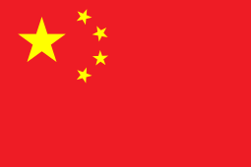
Prisms Through Which to View BRI
Chinese Core Interests
Chinese Communist Party (CCP)
Security (including energy security and supply routes)
Development
Territorial Integrity / Reunification / Sovereignty
China’s Great Rejuvenation / Achieving the Chinese Dream
Returning to China’s historical greatness, which was interrupted by foreign powers (century of humiliation)
Gaining hegemony in the Asia Pacific Region
Notes:
According to Ambassador Chas Freeman in his book, Arts of Power: Statecraft and Diplomacy, “Survival is the supreme national interest. Challenges to it lead to war.”
When you look at Chinese policies domestically as well as their foreign policy, it’s important to recognize that China’s number one interest is for the Chinese Communist Party to survive. The CCP has done its best to ensure that the Chinese people see China and the CCP as one and the same. Likewise, the CCP has worked hard to make sure Chinese citizens see China’s great rejuvenation and achievement of the Chinese dream as being delivered by the CCP.
Therefore, the ability of the CCP to survive is most directly related to China’s ability to continue to grow and provide economic opportunity for its citizens. Up to present, the CCP has made major strides in this regard and most Chinese are very happy with the development that has occurred and are generally willing to overlook some of the more authoritarian internal controls such as the social credit system, party training, surveillance, etc., so long as they continue to see their lots in life improve. Secondarily, I would argue, is the ability to regain lost territories like Taiwan.
China is definitely angling to be the preeminent power in Asia and, I think, will feel a sense of status inconsistency until that status is fully achieved and broadly recognized. Looking back to our own history with the Monroe Doctrine, I don’t think China’s ambitions in this regard should be a surprise to any of us, and particularly given China’s past history as the preeminent power in the region. It’s also important to note that China is an old civilization and Chinese people have a long view of history.
Also, it’s my experience that status and prestige are important to the Chinese and are embedded in the Chinese DNA. Example from education …..choosing big name school at cost over better program at less prestigious school that is scholarship funded; see the same things with experts licenses in China for foreign teachers, etc.
Some might argue that with China’s rapid economic growth of the past two decades beginning to slow, there is a short window of opportunity for China to secure certain geopolitical aims, and most particularly in the Indo-Pacific region. I think there’s some truth to that argument. So, in that vein, BRI could also be seen as developing connectivity and the economic and political advantages that come with it (friendly votes in ASEAN, the African Union, and the UN) while China can afford to self-fund large scale offshore projects, many of which (particularly in South and Southeast Asia) may never see a financial return on investment, but will see a return on investment in terms of energy access, security, and influence.

Slide 11
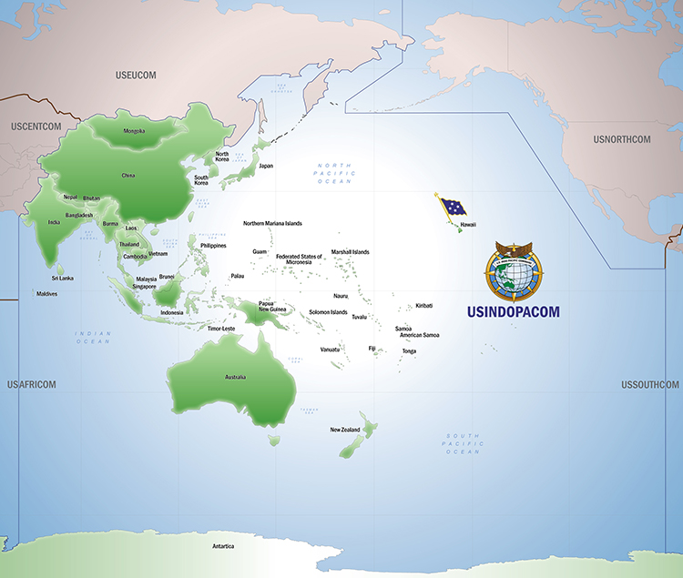
South & Southeast Asian Case Studies
Cambodia and Myanmar are among the countries in Southeast
Asia that are most closely aligned with and/or dependent on China
(Laos is another).
Pakistan and Sri Lanka are among the countries in South Asia that are most closely aligned with and/or dependent on China.
Each of these countries are important to China’s strategic and security interests – pipelines, ports, roads, votes in regional or international bodies, overcoming China’s “Malacca Dilemma,” etc.
The China-Pakistan Economic Corridor (CPEC) is among the most significant recipients of BRI funding to date.
Notes:
Cambodia blocked ASEAN from condemning China for its territorial claims in the South China Sea (2016). When you look at the BRI outside Asia, and you might think of Chinese projects in Africa, it’s important to recognize that African nations represent more than 20 percent of UN voting members and that the African Union is an increasingly important regional organization on the continent. I visited the new African Union building for a meeting in 2019, a building the Chinese funded at a cost of over $200 million. The Chinese particularly like to fund buildings that are prestigious for the hosting government and they label the heck out of them.
When I interviewed Cambodian-American academic Dr. Sophal Ear in 2019 regarding the BRI in Cambodia, he described Cambodia as a subsidiary of China. He said some Chinese projects in Cambodia as shell projects intended only to pass funds to Cambodian officials, while others are clearly tied to China’s geopolitical interests – ports, etc. It’s noteworthy that the last I looked into this deeply, in 2019, China held at least 369,000 hectares of land concessions in Cambodia and had development rights to 20 percent of Cambodia’s coastline. Some such concessions are for 99 years, reminiscent of the unequal treaties that were forced on China by foreign powers in the past.
While Laos is not among the two countries I reviewed in my article on the Belt and Road, since I served there from 2005-2007, I can tell you that China (and Chinese entrepreneurs) have been making a significant push into Laos since the early 2000s, beating out Vietnam as Laos’s traditional big brother. They did this the same way they are doing in other countries – scholarships for students, training for low and mid-level government officials who will rise to power in the next several years, investments….particularly in projects that either create interconnectivity, dependency, or that make the host government look good to their publics (fancy culture halls, presidential palaces, other government buildings, etc). The Chinese do a much better job of labeling and getting credit for what they do for foreign countries compared to the United States.
The China-Myanmar Economic Corridor provides pipelines to the west of the Malacca Strait as well as a Port. China can and has served as Myanmar’s protector within the UN over the Rohinga issue, which gives China additional leverage with Myanmar.
Chaowk Pew (pronunciation of Kyaukphyu

Slide 12
Strategic Implications of China’s Global Power Projection: (INDOPACOM Partner Perspective)
LTCOL Paul Mostafa
Australian Army
Presentation for the
Cultural and Area Studies Office
U.S. Army Command and General Staff College
27 April 2022
unclassified

Slide 13
How and why do things move?
Decisive Conflict
Cooperation
Competition
Conflict
Loss of will/capacity to compete
Limited Conflict
Issue of significant mutual interest

Slide 14
Th Cycles of competition and cooperation
Issue
US deter through M
Ch raise M capability
US raise M capability
Limited Conflict
Issue
US engage through D
Ch reciprocate through D
Compromise
Expand D engagement to other issues

Slide 15
Th The balance of projecting power

Slide 16
What to cooperate on?
The United States and China are committed to cooperating with each other and with other countries to tackle the climate crisis, which must be addressed with the seriousness and urgency that it demands. This includes both enhancing their respective actions and cooperating in multilateral processes, including the United Nations Framework Convention on Climate Change and the Paris Agreement. Both countries recall their historic contribution to the development, adoption, signature, and entry into force of the Paris Agreement through their leadership and collaboration. - U.S.-China Joint Statement Addressing the Climate Crisis 17 Apr 2021
China’s climate envoy Xie Zhenhua to the UN at COP26 “there is more agreement between the US and China than divergence, making it an area of huge potential for cooperation…by working together our two countries can achieve many important things that are beneficial not only to our two countries, but the world as a whole”.
The National Intelligence Council’s recently published report Climate Change and International Response Increasing Challenges to US National Security Through 2040 articulates that a global collective response is required to address the impacts of climate change, going further to suggest that unilateral attempts to counter the effects could have a destabilizing effect.

Slide 17
Some better thoughts than mine!

Slide 18
Questions/Answers/Comments

Slide 20
Contact:
Dr. Mahir Ibrahimov
Director, Cultural & Area Studies Office (CASO)
U.S. Army Command and General Staff College (CGSC)
Fort Leavenworth, KS 66027-2300
Phone: (913) 684-3345
CASO website: https://armyuniversity.edu/cgsc/caso/caso.aspx
YouTube link: https://www.youtube.com/playlist?list=PLkGvnfy3IadNRMPT-sNHpAsz8a3npWBH8
CGSC Facebook: https://www.facebook.com/USACGSC
Contact:
Dr. Mahir Ibrahimov, Director, CREL Management Office (CRELMO)
Fort Leavenworth, KS 66027-2300
Phone: (913) 684-3345
DSN: 552-3345Contact:
Dr. Mahir Ibrahimov, Director, CREL Management Office (CRELMO)
Fort Leavenworth, KS 66027-2300
Phone: (913) 684-3345
DSN: 552-3345
CRELMO website: http://usacac.army.mil/organizations/cace/lrec
ATN: https://atn.army.mil/dsp_template.aspx?dpID=102
https://atn.army.mil
YouTube link: https://www.youtube.com/playlist?list=PLkGvnfy3IadNRMPT-sNHpAsz8a3npWBH8
CRELMO website: http://usacac.army.mil/organizations/cace/lrec
ATN: https://atn.army.mil/dsp_template.aspx?dpID=102
https://atn.army.mil
YouTube link: https://www.youtube.com/playlist?list=PLkGvnfy3IadNRMPT-sNHpAsz8a3npWBH8

